Slide 1
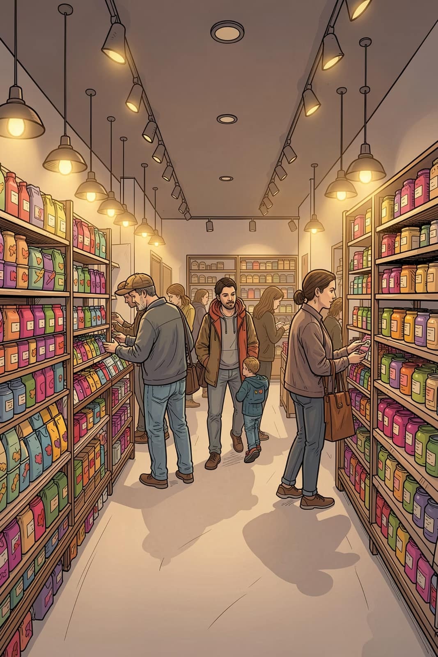
Customer Shopping Behavior Analysis
A deep-dive into transactional data from 3,900 purchases across multiple product categories — uncovering spending patterns, customer segments, product preferences, and subscription behavior to guide strategic business decisions.

Slide 2
Dataset at a Glance
3,900
18
Total Purchases
Data Columns
Transactions analyzed across all categories
Demographics, purchase details & behavior
$59.76
3.75
Avg. Purchase
Avg. Rating
Average transaction value across all customers
Average review rating out of 5.0
Key features span customer demographics (Age, Gender, Location, Subscription Status), purchase details (Item, Category, Amount, Season), and shopping behavior (Discounts, Promo Codes, Purchase Frequency, Shipping Type).

Slide 3
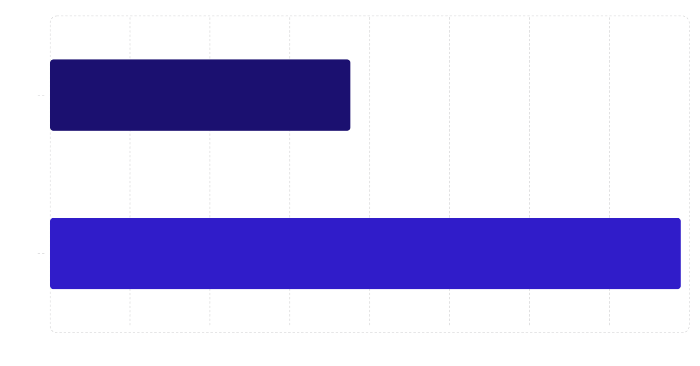
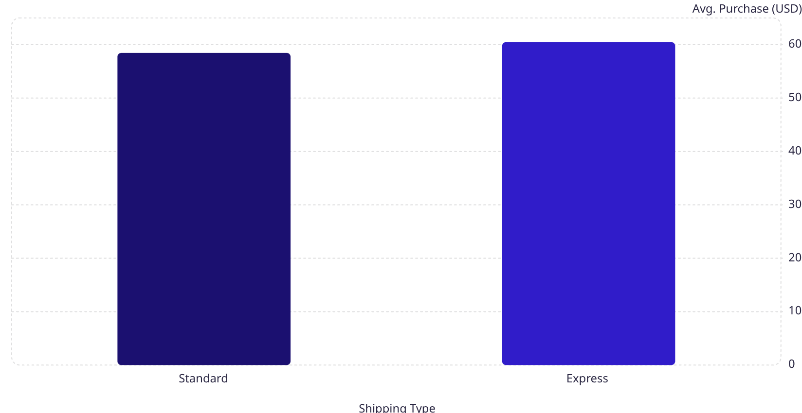
Revenue by Gender & Shipping Type
Revenue by Gender
Shipping Type vs. Avg. Spend
Male customers generated significantly more revenue than female customers across all categories.
Express shipping customers spend slightly more on average than Standard shipping customers — suggesting a higher-value buyer profile.

Slide 4

Customer Segmentation
Customers were classified into three segments based on purchase history. The data reveals a highly loyal customer base.
Loyal
Returning
3,116 customers — the dominant segment, representing repeat, high-frequency buyers who form the backbone of revenue.
701 customers — shoppers who have come back but have not yet reached loyal status. A key conversion opportunity.
New
83 customers — first-time buyers with high potential for nurturing into the returning and loyal segments.

Slide 5
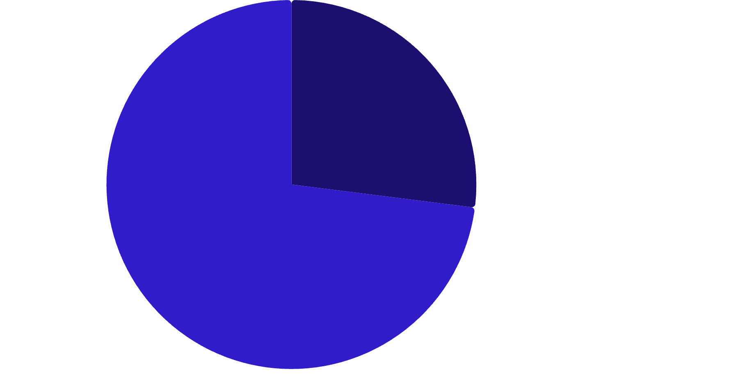
Subscribers vs. Non-Subscribers
Key Findings
Only 27% of customers hold an active subscription, yet subscribers and non-subscribers spend nearly the same on average.
Subscribed (Yes)·27%
·27%
·
Not Subscribed (No)·73%
Status
Customers
Avg. Spend
Total Revenue
·73%
·
Subscribed
1,053
$59.49
$62,645
Not Subscribed
2,847
$59.87
$170,436
The large non-subscriber base represents a major opportunity to convert casual buyers into loyal, subscription-driven customers.

Slide 6

Top-Rated Products & Discount-Dependent Items
Top 5 Products by Avg. Rating
Top 5 Discount-Dependent Products
Product
Avg. Rating
Product
Discount Rate
Gloves
3.86
Hat
50.00%
Sandals
3.84
Sneakers
49.66%
Boots
3.82
Coat
49.07%
Hat
3.80
Sweater
48.17%
Skirt
3.78
Pants
47.37%
Hat appears in both lists — it is highly rated yet heavily discount-dependent, signaling a pricing strategy review opportunity.

Slide 7
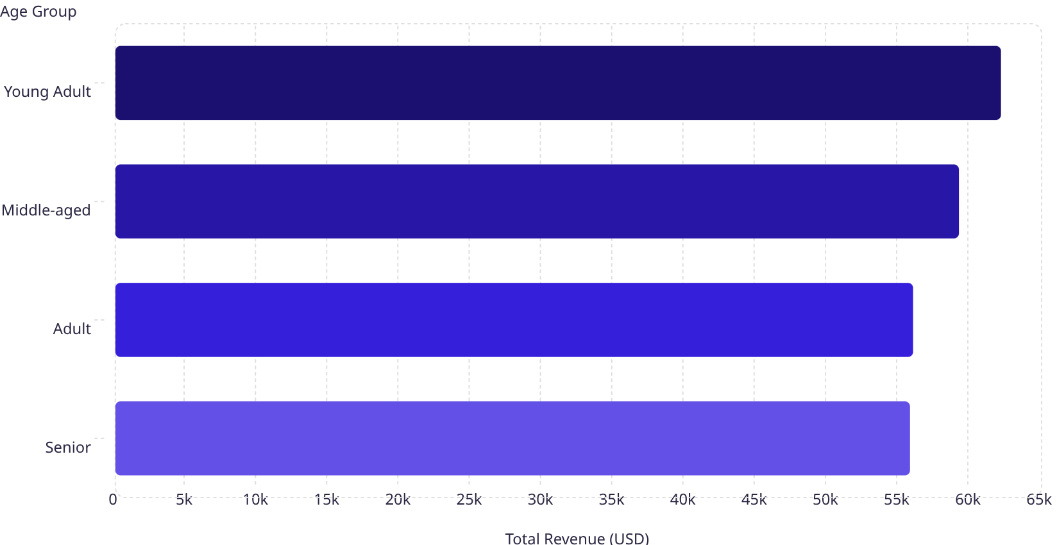
Revenue by Age Group & Repeat Buyers
Repeat Buyers & Subscriptions
62.1k
Among customers with more than 5 purchases, the majority are not subscribed — revealing a gap between loyalty behavior and formal subscription uptake.
59.2k
56k
Subscription
Repeat Buyers (>5 purchases)
55.8k
No
2,518
Yes
958
Young Adults lead in revenue at $62,143, making them the most valuable age segment to target.

Slide 8
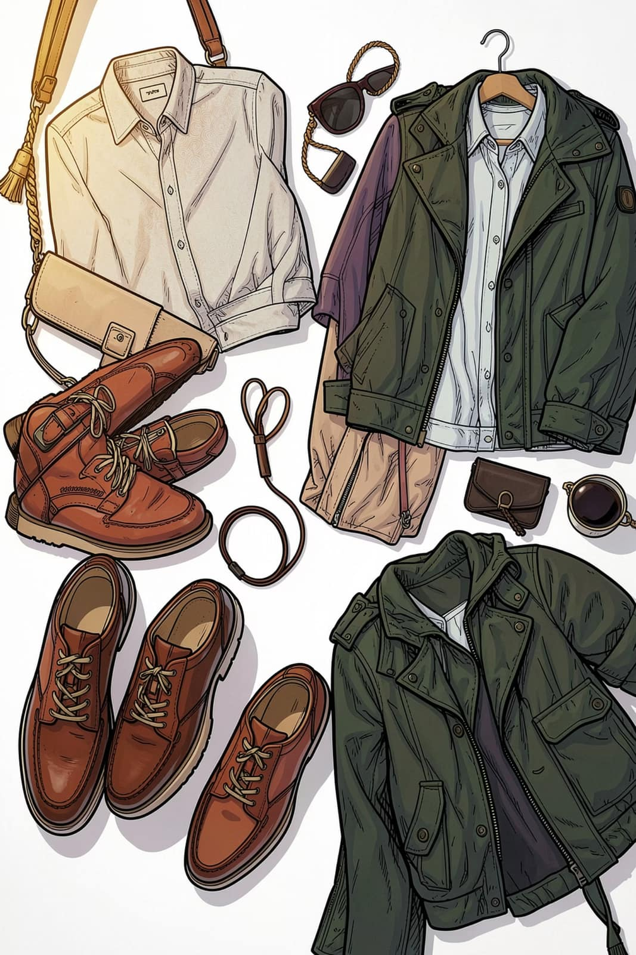
Top Products by Category
Accessories
Jewelry — 171 orders
Sunglasses — 161 orders
Belt — 161 orders
Clothing
Blouse — 171 orders
Pants — 171 orders
Shirt — 169 orders
Footwear
Sandals — 160 orders
Shoes — 150 orders
Sneakers — 145 orders
Outerwear
Jacket — 163 orders
Coat — 161 orders

Slide 9

Business Recommendations
Boost Subscriptions
Promote exclusive benefits to convert the 73% non-subscriber base, especially high-frequency repeat buyers who already behave like subscribers.
Customer Loyalty Programs
Reward returning customers to accelerate their move into the Loyal segment and reduce churn among the 701 returning buyers.
Review Discount Policy
Products like Hat and Sneakers have near-50% discount rates. Balance promotional boosts with margin protection through targeted discount caps.
Product Positioning & Targeted Marketing
Highlight top-rated products (Gloves, Sandals, Boots) in campaigns. Focus marketing spend on Young Adults and express-shipping users for maximum ROI.

